Slide 2


Analysis of FPAs in the LHC RB circuit
Christoph Obermair, TE-MPE-CB Lukas Felsberger, TE-MPE-MI Franz Pernkopf, TU-Graz Andrea Apollonio, TE-MPE-CB Daniel Wollmann, TE-MPE-CB

Slide 3
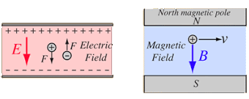
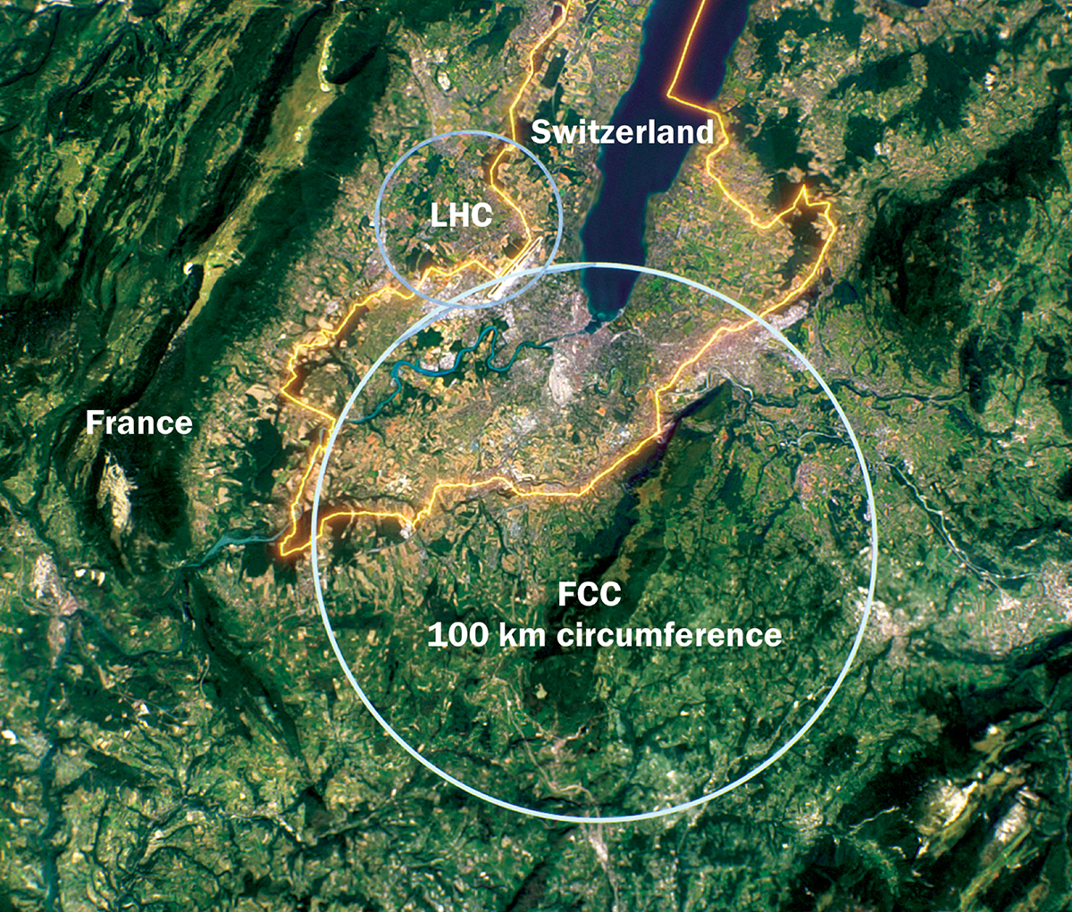
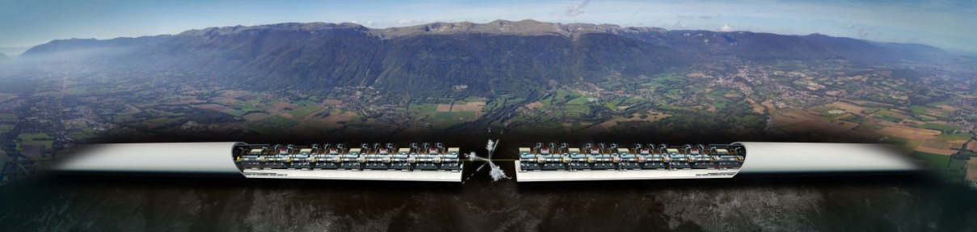
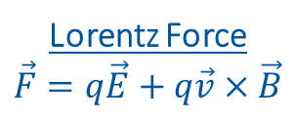
Introduction to Accelerators
Principle: Accelerate particles with electric field, and analyze collissions with target.
Types:
Linear accelerators - Linear accelerator 4 (Linac4)
Limitation to high collission energy is electric field
Breakdowns can destry radio frequency cavities
Circular accelerators - Large Hadron Collider (LHC)
Limitation to high collission energy is electric field
Quenches can destroy magnets
Current LHC status: LHC page 1
Lorentz Force
$$\vec{F}=q\vec{E}+q\vec{v}×\vec{B}$$
CLIC concept image

Slide 4
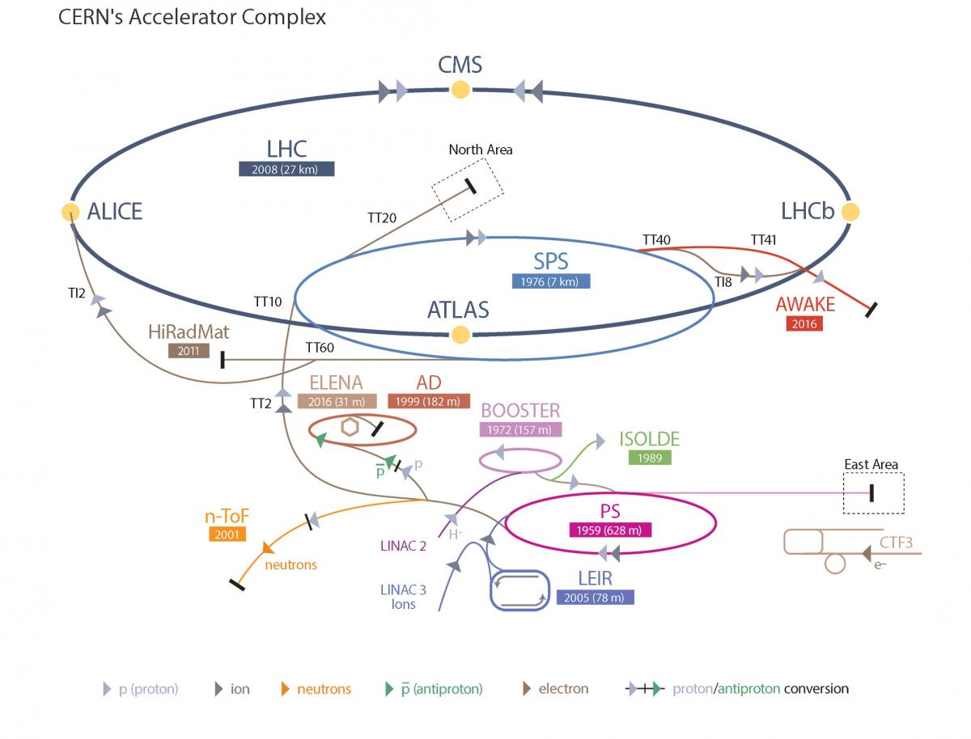
Large Hadron Collider - LHC
LHC Facts
Cost of the LHC | 4332 MCHF
Length | 26 659 m
Dipole operating temperature | -271.3°C
Cost per magnet | ~ 1 MCHF
Number of main dipoles | 1232
Power consumtion | 1.3 TWh/a
Number of circuits | 8
Stored energy per circuit | 1.1 GJ (380-ton TGV @ 50km/h)
2/23/2023

Slide 5
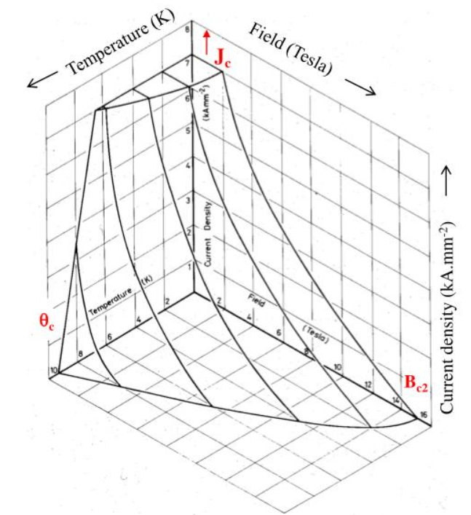
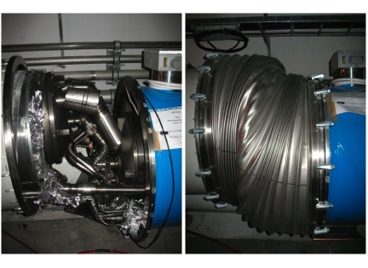
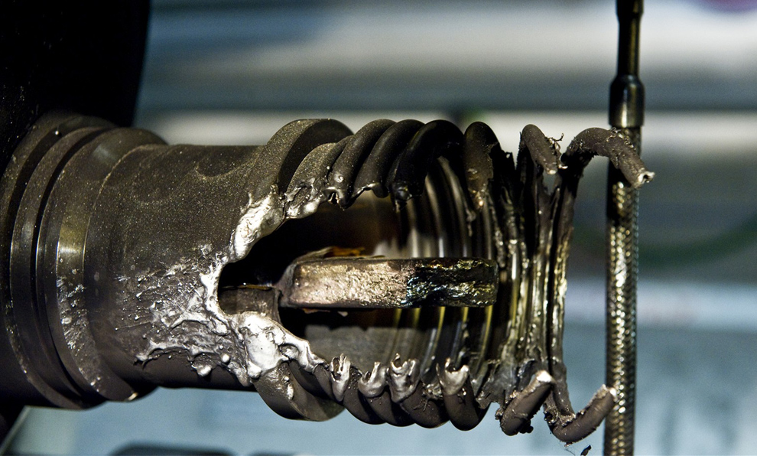
Quench Protection
Quench is biggest threat to LHC dipole magnets
Different types of quench:
Primary quench
Secondary quench: GHe propagation, EM disturbance,..
Quench Protection:
Bypass Diode
Quench Heater
Quenches with destructed magnets:
2008 (~100 destroyed magnets – splice opened)
2021 HWC (1 destroyed magnet - interturn short in coil)
Possible precursor detected 1 month before
Precursor: Oscillation in U_Diode Voltage
Goal: Further precursors?
Critical surface NbTi

Slide 6
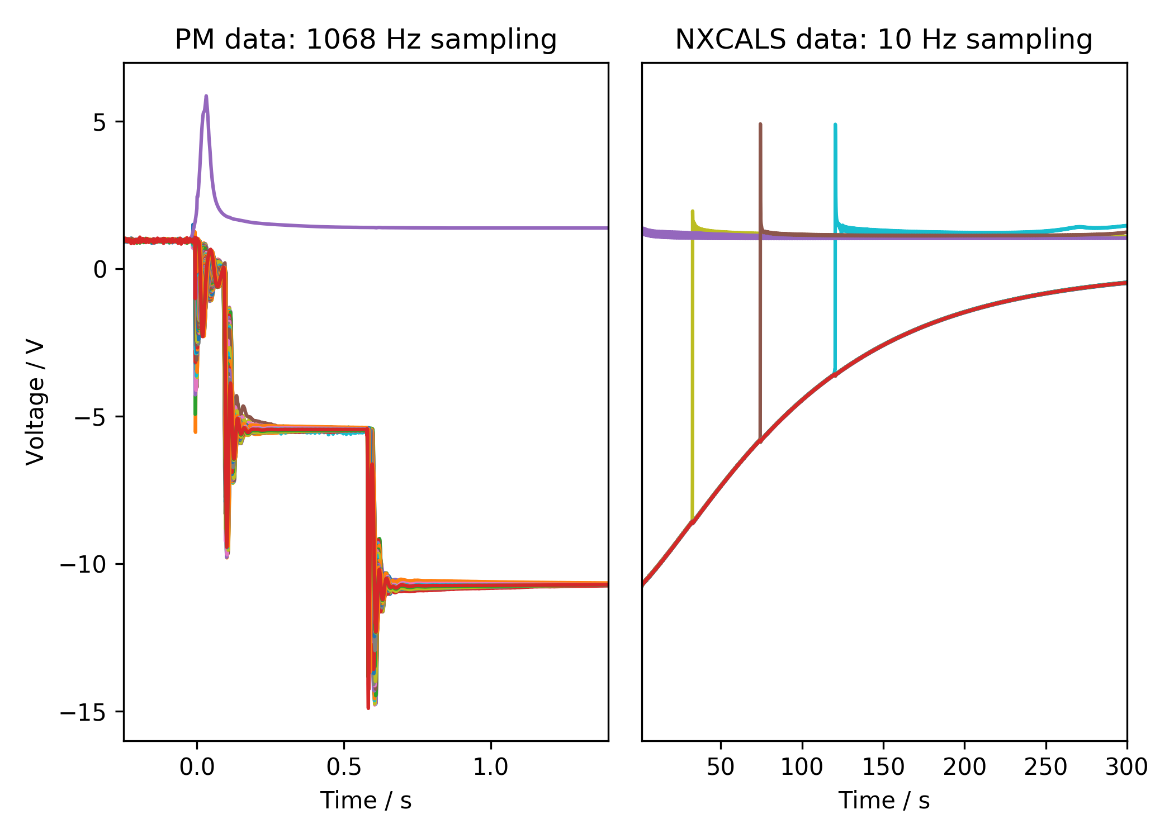
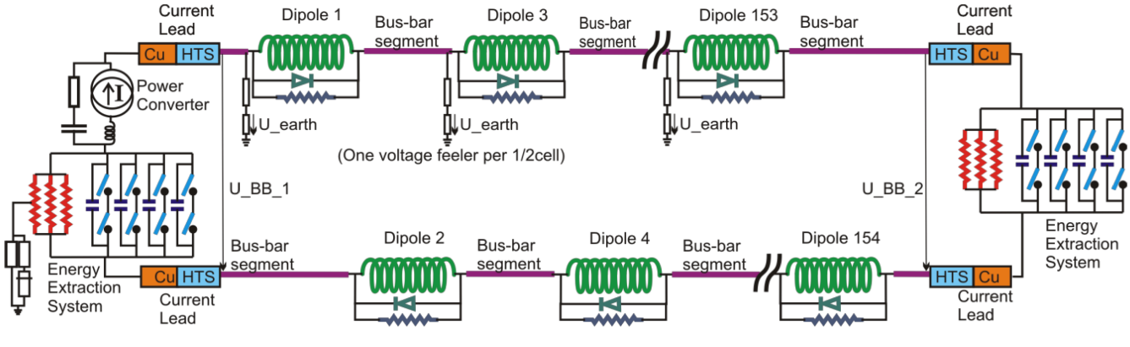
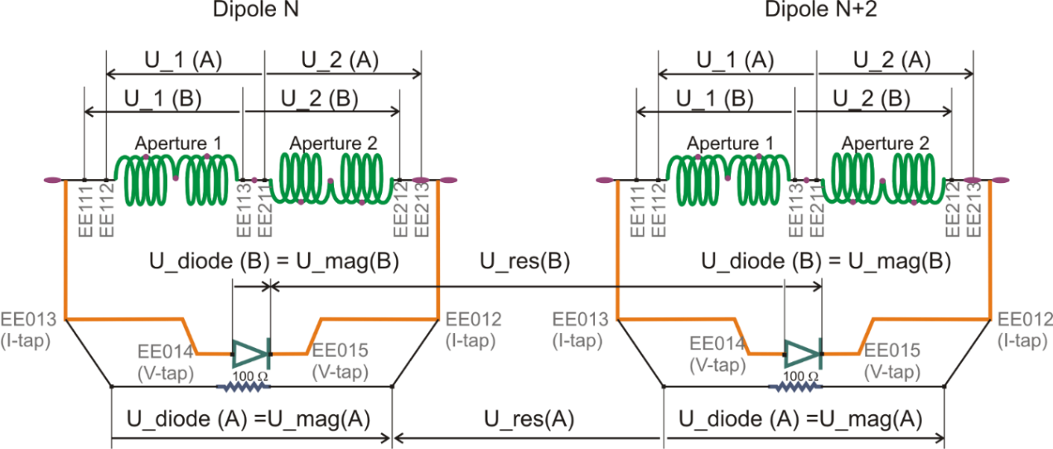
Quench Protection: U-Diode
Analyzed Area
Analyzed Area
2nd EE switch off
Secondary quench
1st EE switch off
PC Switch off

Slide 7
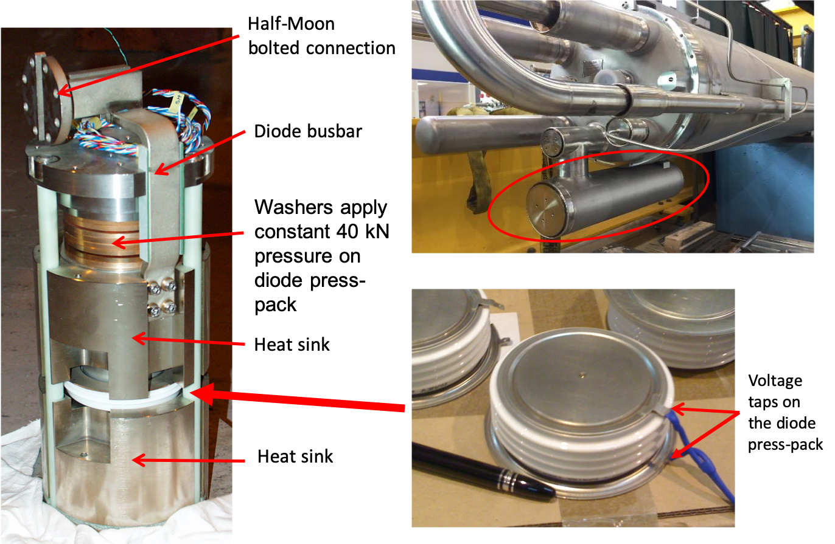
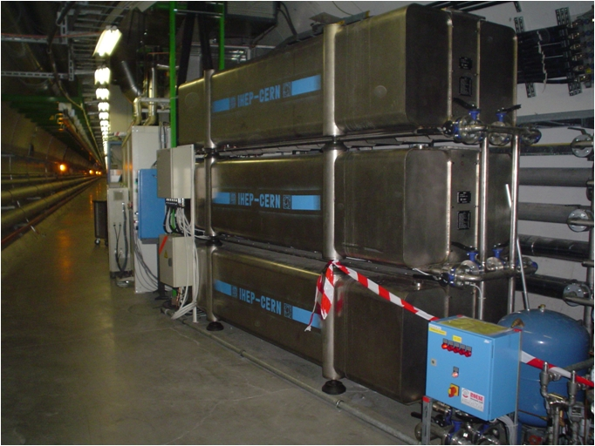
Hardware
Diode
Energy Extraction Resistance

Slide 8
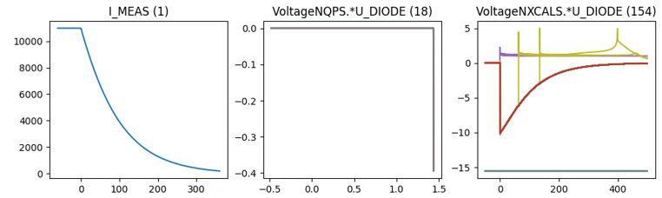
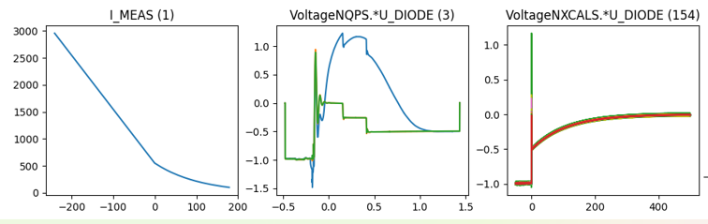
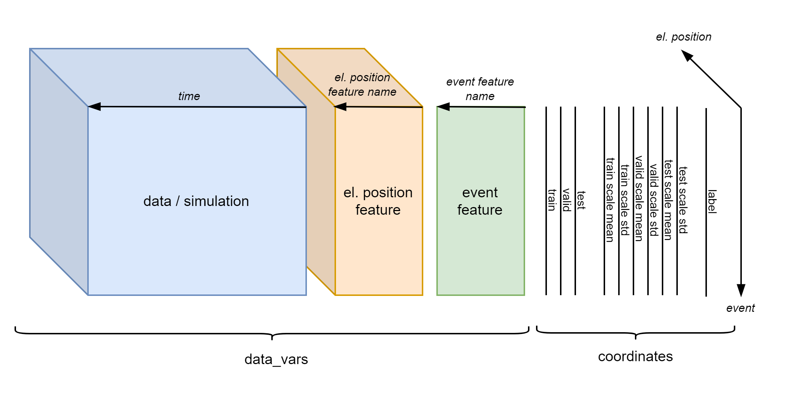
Existing Database Overview
Data overview
Filtered events
 | Signal | 2014-2020 | 2021 | # events
Real Data | U_DIODE_NXCALS | P | P | 867
 | U_DIODE_PM | P | P | 629
 | I_MEAS | P | P | 896
 | U_QSO, U_1, U_2 | P | P | 893
 | I_EARTH_PCNT | P | P | 895
 | I_EARTH | P | P | 629
 | I_HDS, U_HDS | P | P | 896
 | EEUDumpResPM | P | P | 896
Simulations | V(0v_magf*) | P | P | 875
 | I(r1_warm) | P | P | 875
 | V(10,11), V(18,19) | P | P | 875
#events |  | 267 | 629 | 560/896

Slide 9
What are the expected oscillations after a quench?

Slide 10
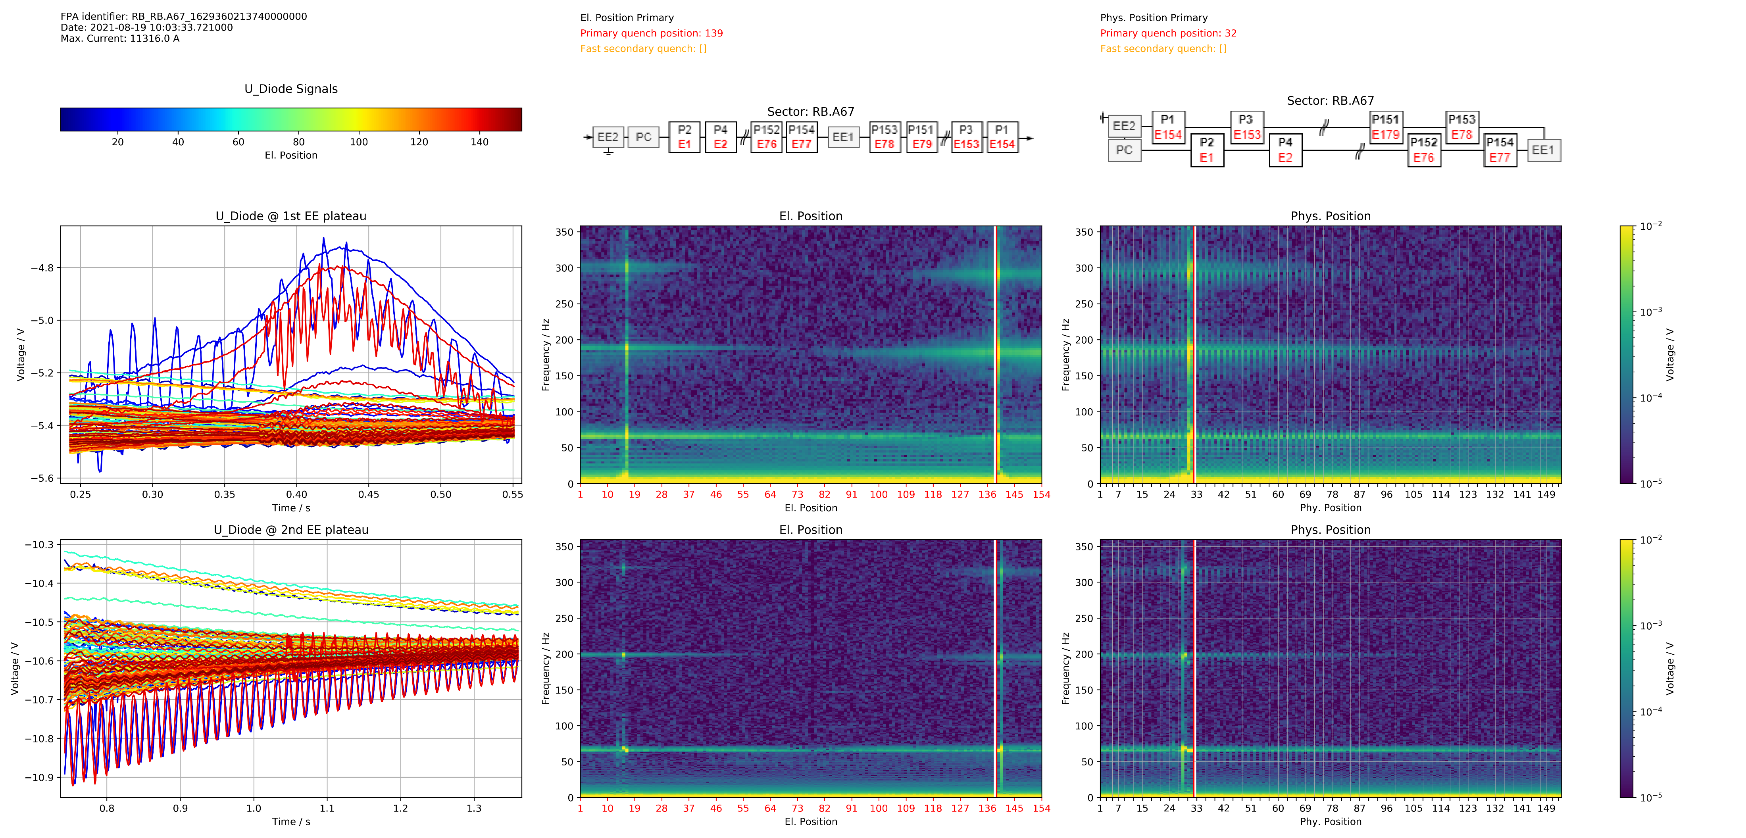
Position Frequency (FP) Map

Slide 11
Sort Magnets differently

Slide 12
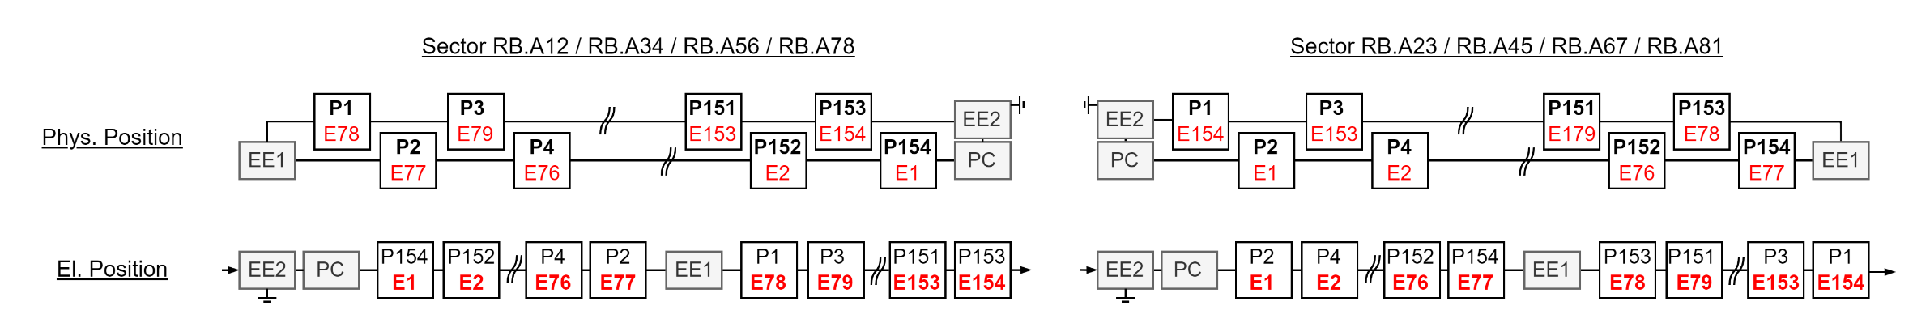
El. Vs Phys. Position

Slide 13
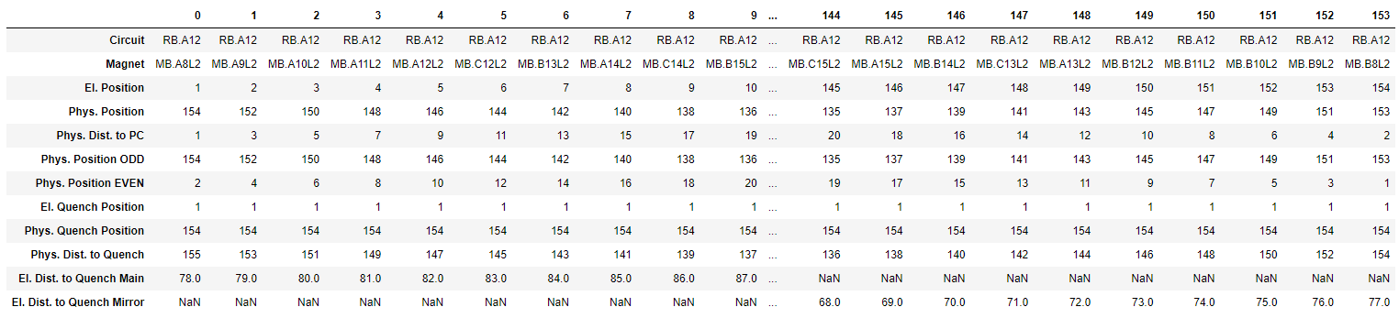
ODD: El. Vs Phys. Position Table

Slide 14
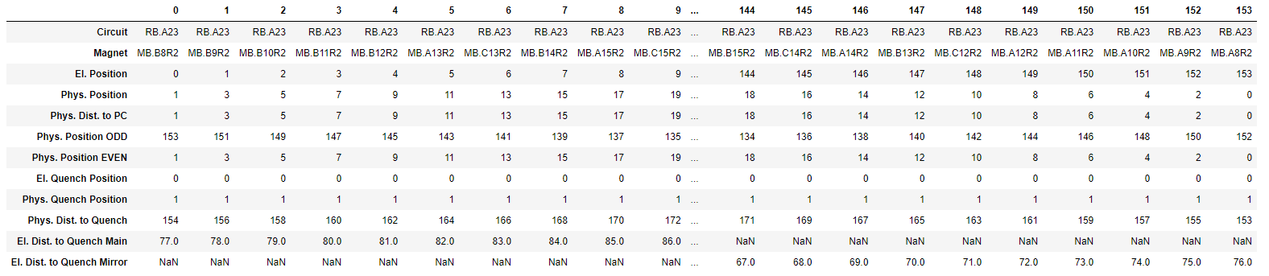
EVEN

Slide 15
How are the FP-maps composed?

Slide 16
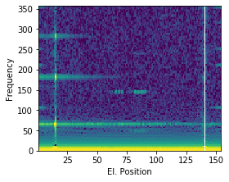
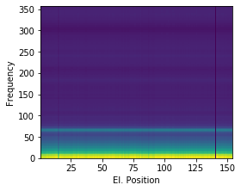
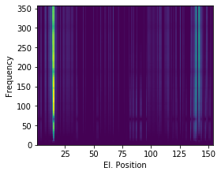
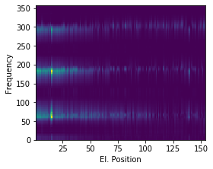
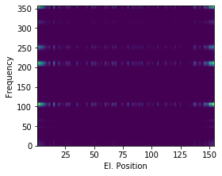
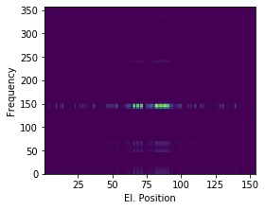





How are the FP-maps composed?
$$≈$$
$$+$$
$$+$$
$$+$$
$$+$$
Common Oscillation
Physical Propagation
Electrical Propagation
Power Converter
Energy Extraction
Event:
RB_RB.A78_1617170255140000000
2021-03-31 07:57:35.120000

Slide 17
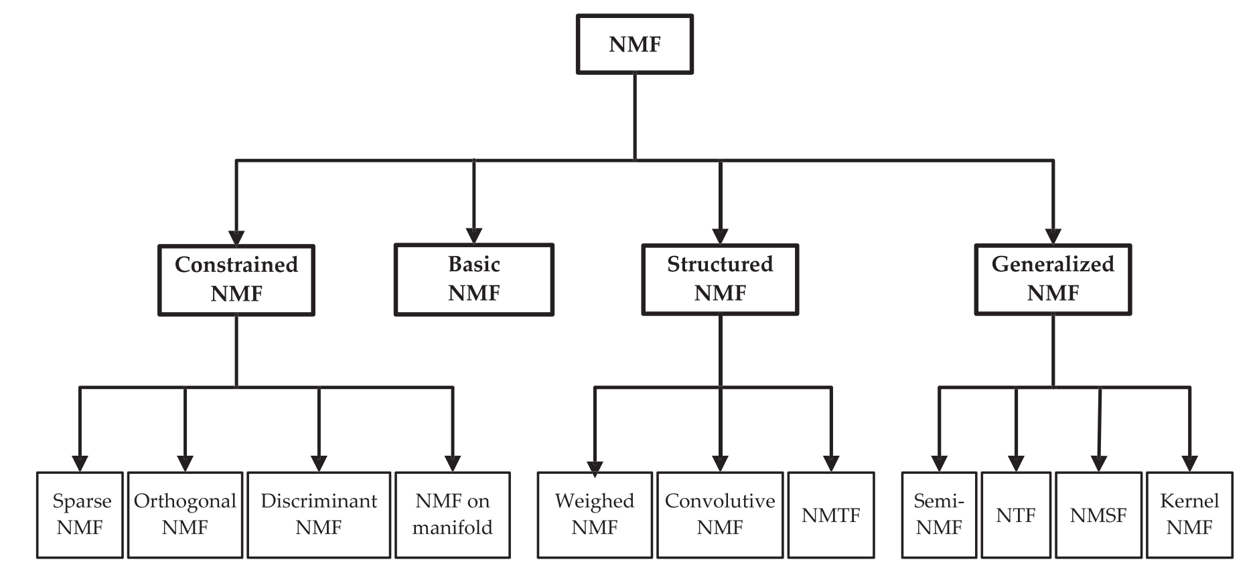
Non-Negative Matrix Factorization

Slide 18
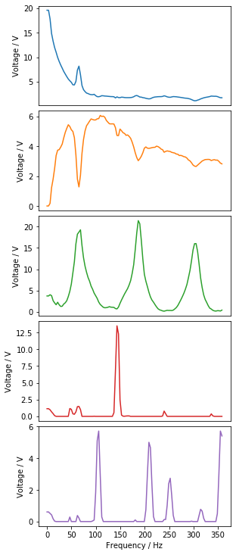
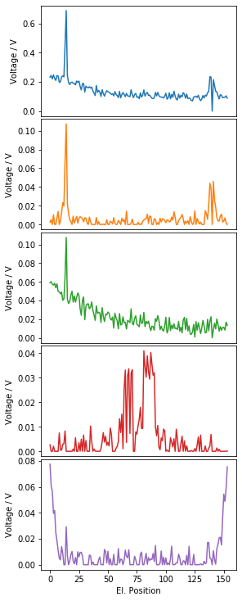
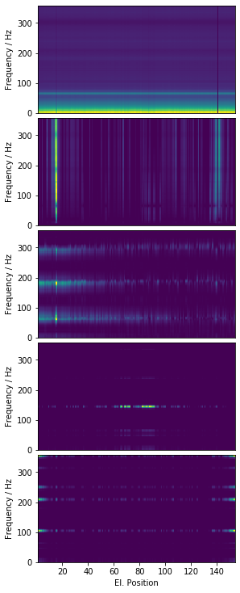
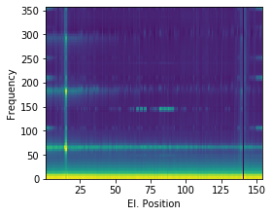
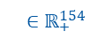

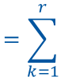
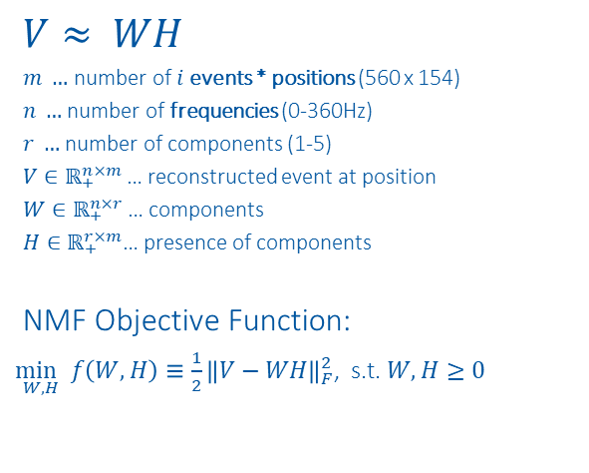
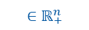
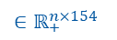
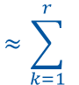
NMF on Position Frequency Maps
$$V≈ WH$$
$m …$ number of $i$events * positions (560 x 154)
$n …$ number of frequencies (0-360Hz)
$r …$ number of components (1-5)
$V∈ℝ_{+}^{n×m}$… reconstructed event at position
$W∈ℝ_{+}^{n×r}$… components
$H∈ℝ_{+}^{r×m}$… presence of components
NMF Objective Function:
$\underset{W,H}{\min{ }}f\left(W, H\right)≡\frac{1}{2}{\left\|V−WH\right\|}_{F}^{2}$, s.t. $W, H≥0$
$$V_{:,i:i+154} ≈ \sum_{k=1}^{r}{{ W}_{:,k}{ H}_{k,i:i+154} =}\sum_{k=1}^{r}{{ WH}_{k, i:i+154} = {WH}_{i:i+154}}$$
$${∈ℝ}_{+}^{n×154}$$
$${ ∈ℝ}_{+}^{n}$$
$${ ∈ℝ}_{+}^{154}$$
$${∈ℝ}_{+}^{n×154}$$
$${∈ℝ}_{+}^{n×154}$$
$$≈\sum_{k=1}^{r}{ }$$
$$⋅$$
$$=\sum_{k=1}^{r}{ }$$
$$=$$
$$⋅$$
$$⋅$$
$$⋅$$
$$⋅$$
https://www.nature.com/articles/44565
https://proceedings.neurips.cc/paper/2000/file/f9d1152547c0bde01830b7e8bd60024c-Paper.pdf

Slide 19
2021-03-31 07:57:35.120000

Slide 20
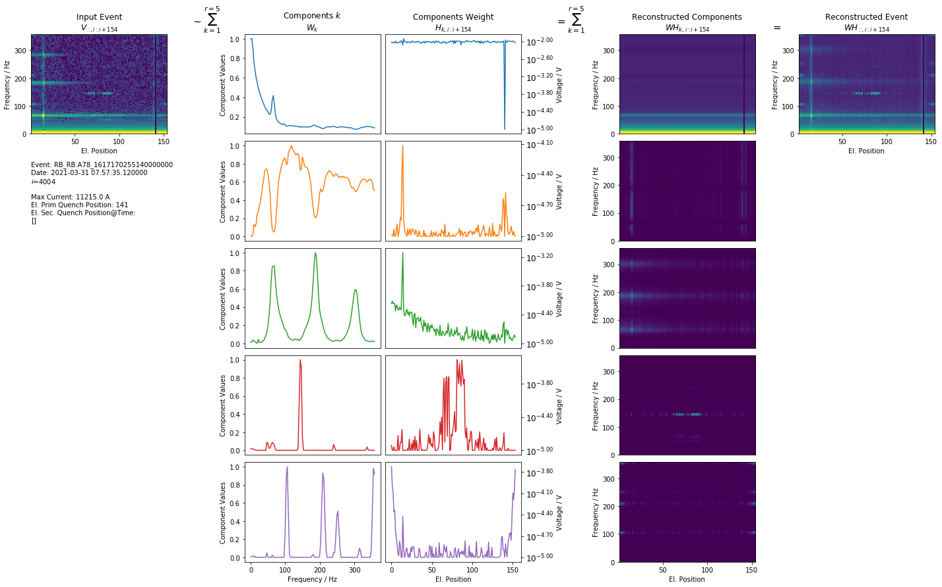
1st EE 2021-03-31 07:57:35.120000

Slide 21
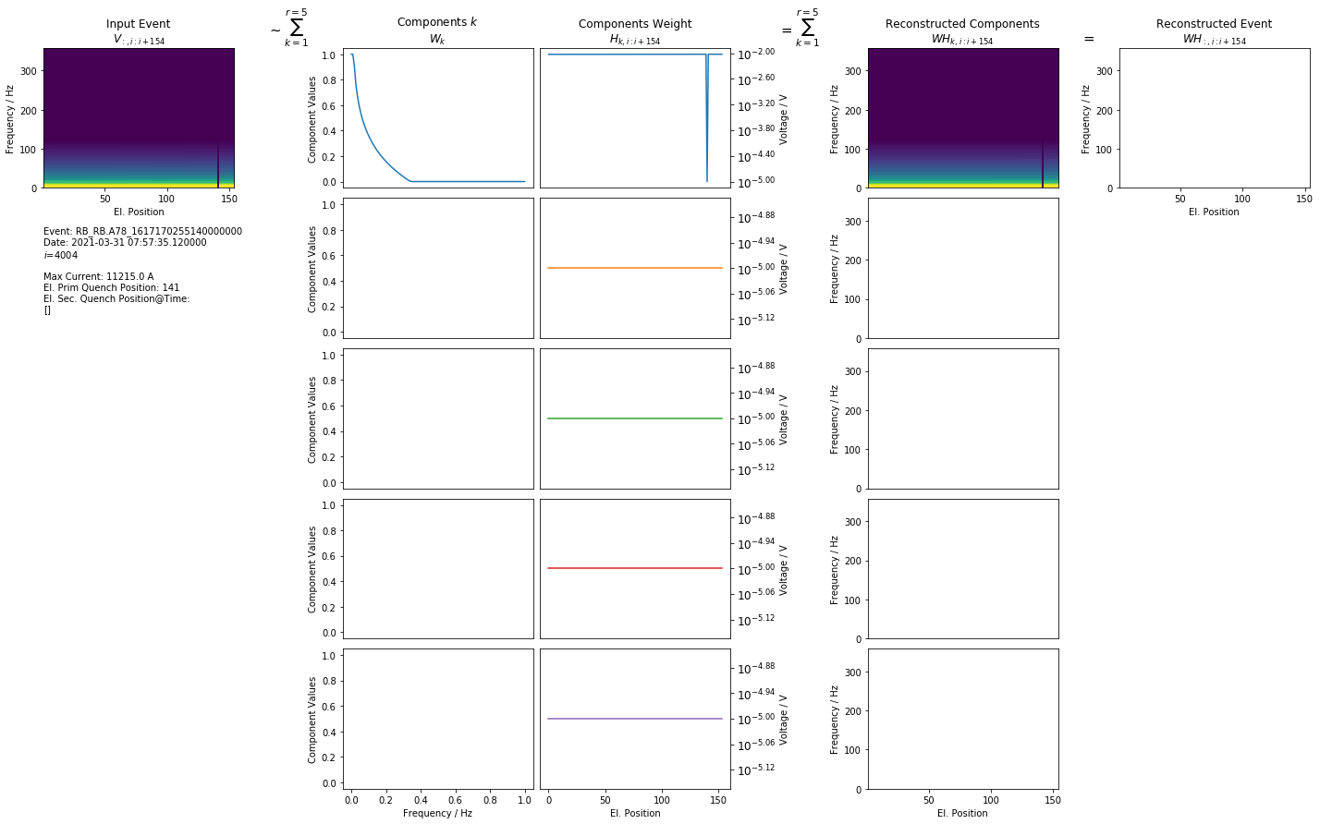
Simulation 1st EE 2021-03-31 07:57:35.12

Slide 22
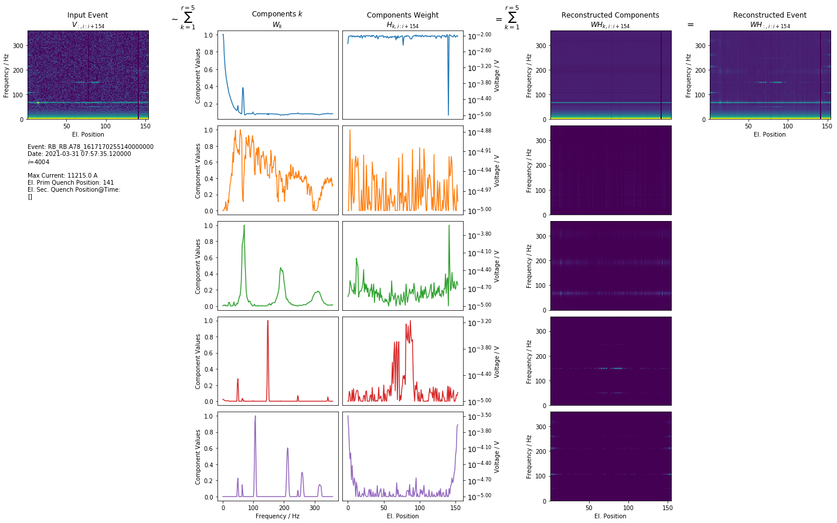
2nd EE 2021-03-31 07:57:35.120000

Slide 23
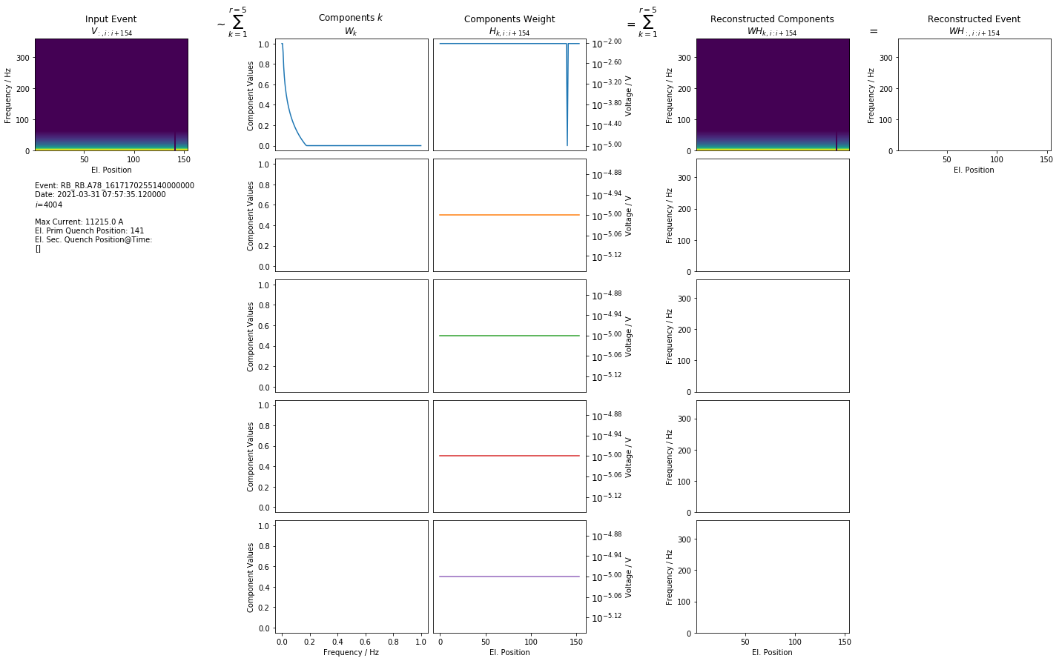
Simulation 2nd EE 2021-03-31 07:57:35.12

Slide 24
1st EE Component Generalization

Slide 25
1st EE: Average Weight of Component 0
$→$ Frequency propagates along axis with lowest $SNR$ ($SNR=\frac{μ}{σ}$)

Slide 26
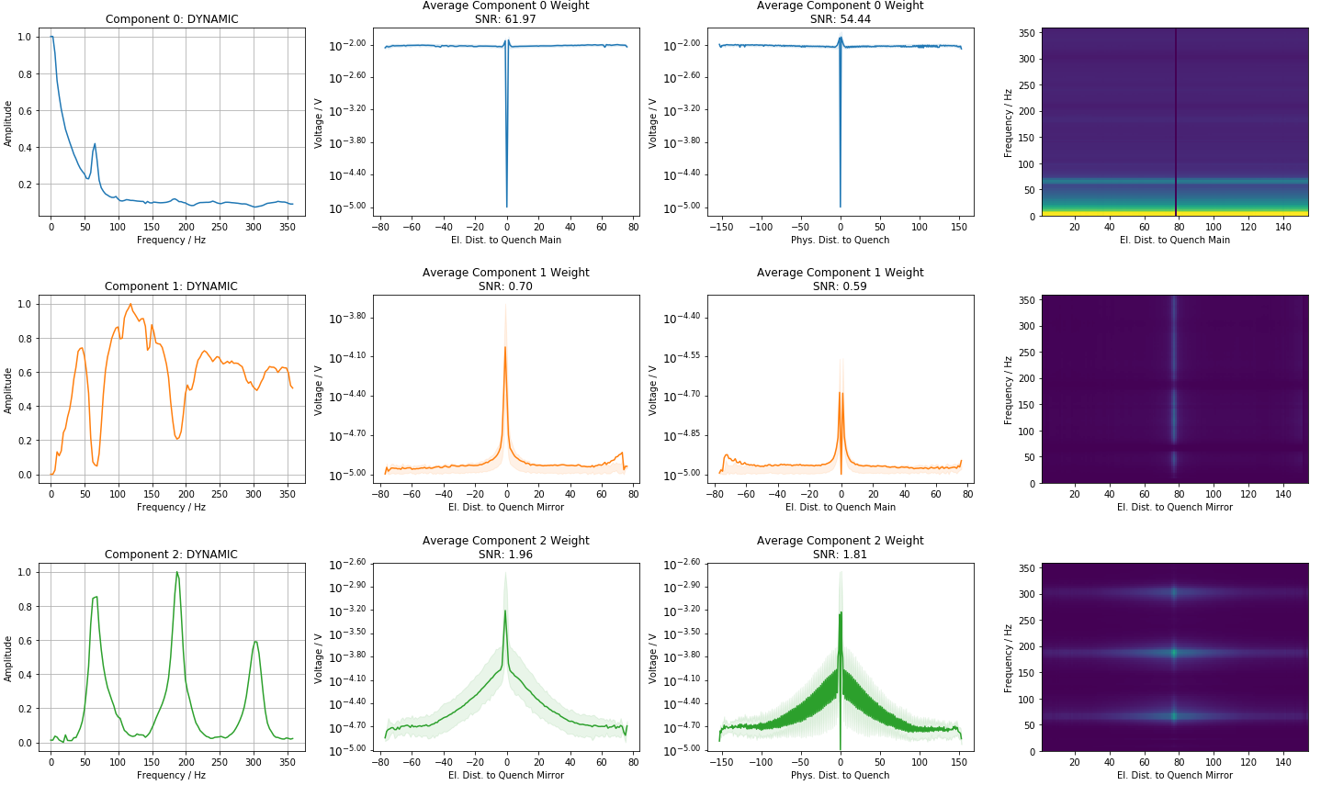
1st EE: Average Weight of Components

Slide 27
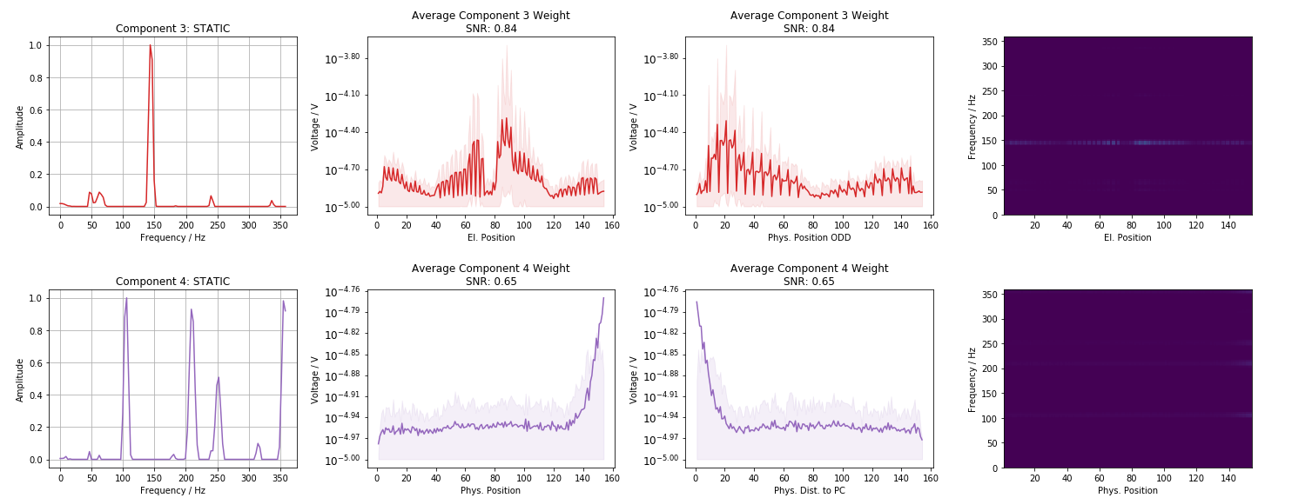
1st EE: Average Weight of Components

Slide 28
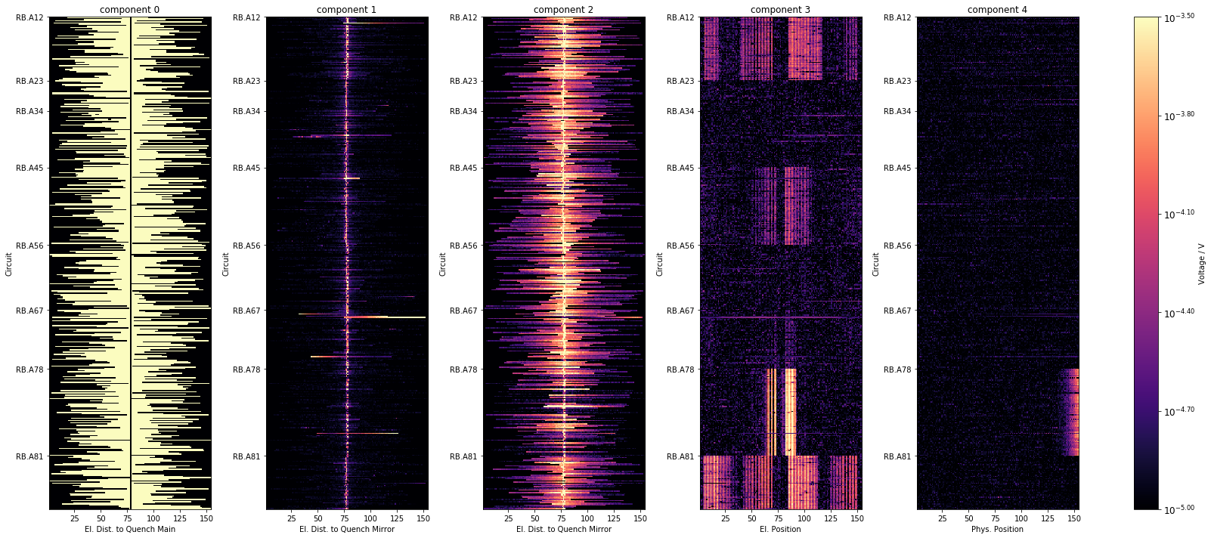
1st EE: Component distribution over Sector
All events from 2021, excl. events with fast sec. quenches

Slide 29
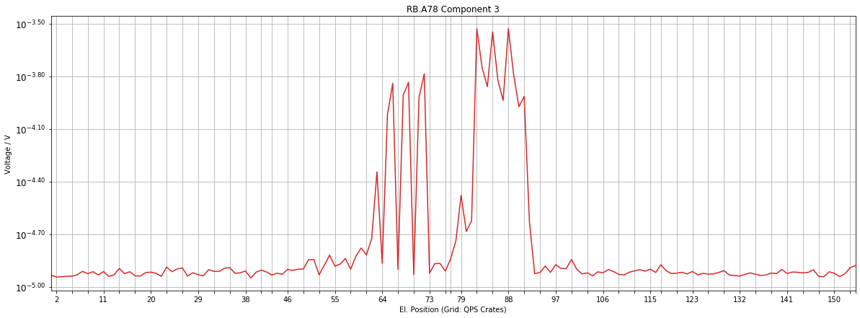
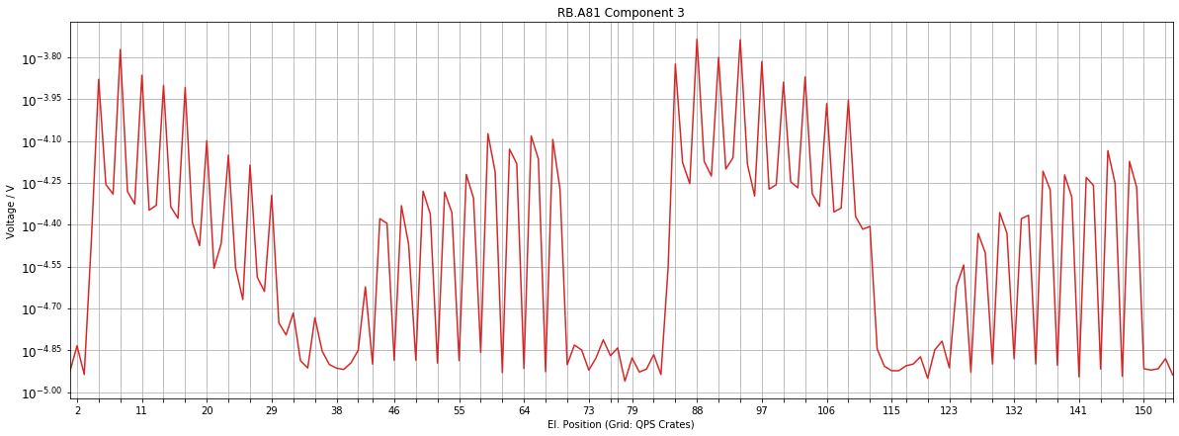
1st EE: Component 3: QPS Crate Grid

Slide 30
1st EE Correlation

Slide 31
Pearson Correlation Coefficient

Slide 32
Pearson Correlation Coefficient

Slide 33
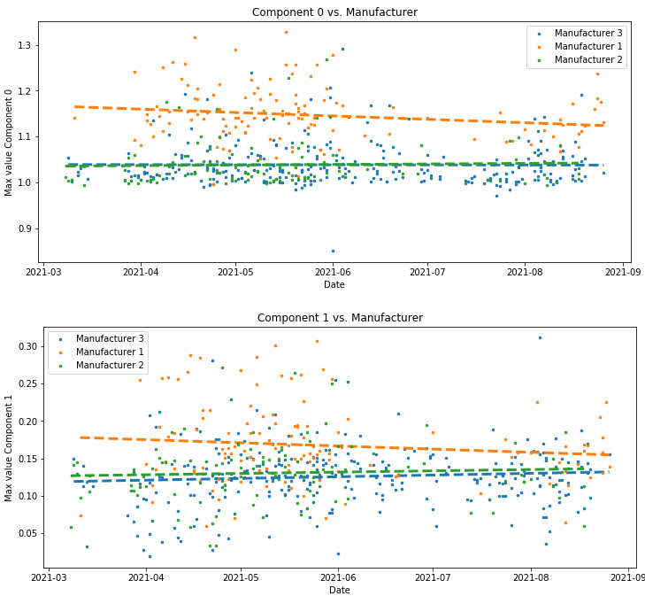
Plot features with high correlation

Slide 34
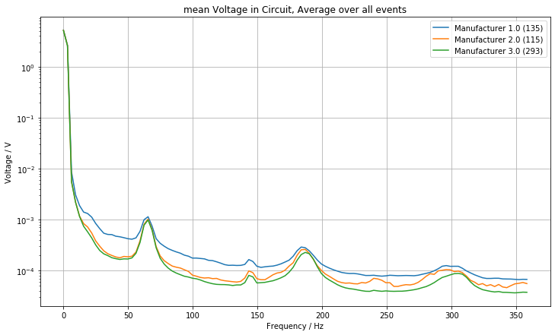
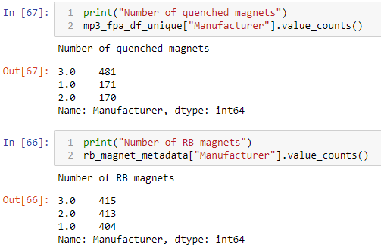
Plot features with high correlation

Slide 35
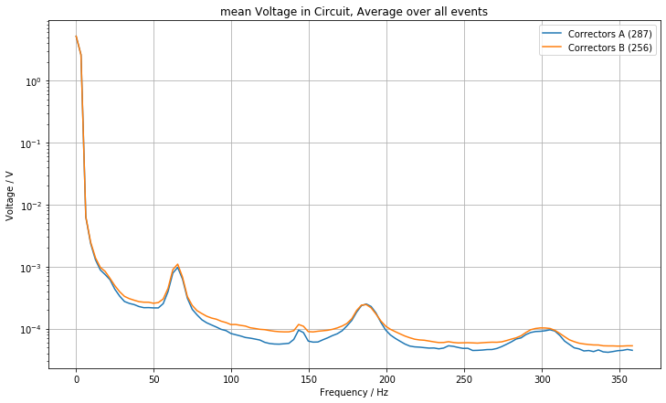
Plot features with high correlation

Slide 36

Plot features with high correlation

Slide 37

Plot features with high correlation

Slide 38




Plot features with high correlation

Slide 39
1st EE Component Correlation

Slide 40

Plot features with high correlation

Slide 41

Plot features with high correlation

Slide 42

Plot features with high correlation

Slide 43

Energy component 2

Slide 44
2nd EE: Component Generalization

Slide 45

2nd EE: Average Weight of Components

Slide 46

2nd EE: Average Weight of Components

Slide 47

2nd EE: Component distribution over Sector
All events from 2021, excl. events with fast sec. quenches

Slide 48

Recreate Events

Slide 49
Snapshots

Slide 50

Snapshots: 1st EE 2022-03-11 17:02:12

Slide 51

Snapshots 1st EE: Distribution over Sector
47/64 events successfully downloaded.

Slide 52

Snapshots 1st EE: Distribution over Current
47/64 events successfully downloaded.

Slide 53

Snapshots: 2nd EE 2022-03-11 17:02:12

Slide 54

Snapshots 2nd EE: Distribution over Sector
47/64 events successfully downloaded.

Slide 55

Snapshots 2nd EE: Distribution over Current
47/64 events successfully downloaded.

Slide 56

Next Steps
Find normal components -> optimize regularization + hyperparameters for NMF
Improve NMF:
Split in trainable non-trainable components
Sanity Check:
Check NMF components Snapshots
Component distribution:
Distribution over sector, sec. quench type (training, QH trigger), time, intercoil short sector
Isolate normal NMF components:
Which el. components are causing them
Fix normal NMF components (no update in $W$)-> Find anomaly component:
Which component occurs in faulty magnets
How does component weight change over time

Slide 58

2nd EE: Component distribution over 2021
All events from 2021, excl. events with fast sec. quenches

Slide 59

1st EE: Component distribution over 2021
All events from 2021, excl. events with fast sec. quenches

Slide 60

Snapshots 2nd EE: Distribution over 2021
47/64 events successfully downloaded.

Slide 61

Snapshots 1st EE: Distribution over 2021
47/64 events successfully downloaded.

Slide 62

1st EE: Component distribution over Sector

Slide 63

1st EE: Distribution over Months in 2021

Slide 64

1st EE: Distribution over Current

Slide 65

2nd EE: Component distribution over Sector

Slide 66

Snapshots 1st EE: Distribution over Sector

Slide 67

Snapshots 2nd EE: Distribution over Sector

Slide 68
What are the expected oscillations after a quench?

Slide 69




Generalization
To calculate statistics, quench must occur at same position
Not consider events with secondary quenches
Split into
MAIN: Half where quench occurred
MIRROR: Other Half

Slide 70





Quantiles
1st quantile
median
3rd quantile

Slide 71





Find Peaks 3rd Quantil
302.1 Hz
183.8 Hz
143.3 Hz
65.4 Hz

Slide 72





Voltage = f(Quantile)
302.1 Hz
1st Plateau
$${10}^{−3.11} V$$
183.8 Hz
$${10}^{−4.06} V$$
$${10}^{−4.14} V$$
$${10}^{−4.34} V$$
143.3 Hz
3rd Quantil (0.75)
65.4 Hz

Slide 73

Voltage = f(Quantile)
1st Plateau
2nd Plateau

Slide 74
Further NMF examples

Slide 75

RB.A23 2021-03-09 07:39:33

Slide 76

1st EE RB.A23 2021-03-09 07:39:33

Slide 77

2nd EE RB.A23 2021-03-09 07:39:33

Slide 78








NMF Examples
$$≈\sum_{k=1}^{r}{ }$$
$$⋅$$
$$=\sum_{k=1}^{r}{ }$$
$$=$$
$$⋅$$
$$⋅$$
$$⋅$$
$$⋅$$

Slide 79





NMF Examples
$$≈\sum_{k=1}^{r}{ }$$
$$⋅$$
$$=\sum_{k=1}^{r}{ }$$
$$=$$
$$⋅$$
$$⋅$$
$$⋅$$
$$⋅$$

Slide 80
Sanity Checks

Slide 81




Kirchhoff
$$−U_{BB_{1}}+U_{BB_{2}}+\sum_{n=1}^{154}{U_{Diode}\left(n\right)}=0$$
Challenges: (1) Sampling (2) Time-alignment

Slide 82


FFT sanity check

Slide 83

Data - Simulation

Slide 84



Signal vs. scaled signal
Signal
Scaling: $x_{scaled}=\frac{x−mean\left(x\right)}{std(x)}$
Scaled Signal

Slide 85
Old Slides

Slide 86

Overview of Data-Driven Models
High incorporation of knowledge and context
Data-Driven Models
Manual Feature Engineering
Manual Threshold
Probabilistic
Classic Machine Learning
Automatic Feature Eningeering
Discriminative Deep Learning
Generative Deep Learning
GAN, RNN, ProtoNET
MLP, DCNN, FCN
SVM, Random Forrest, MLP
e.g. Busbar Resistance
e.g. QH Analysis
Fully data driven
Physical Models
Dataset | 1. Feature analysis | 2. Find probabilities/correlations | 3. Finding concepts | 4. Predict parameters | 5. Generate data
1. U Diode Secondary Quench | Oscillation types | Oscillation evolvement
2. U Diode Primary Quench | Oscillation types | Oscillation evolvement | tSNE concepts | Predict sec. quench
3. U Diode Full Quench |  |  |  | Fit simulations | Reconstruct data

Slide 87


1. U Diode Secondary Quench

Slide 88


Manual Feature Engineering
Classification of oscillations after secondary quenches
-2
0
150
-1
1
151

Slide 89


Manual Feature Engineering
2
3
4
2
3
1
min_time, max_time
min_amplitude, max_amplitude
dU_min, dU_max
dstd_max
wiggle_area_pos, wiggle_area_elpos
dstd score: $\frac{mean(wiggle area)}{mean(non wiggle area)}$
Using phys. position, el. position
Different window functions
5
5

Slide 90





1. Oscillation that only propagates electrically
Reason: electric coupling?
2. Oscillation that propagates physically and electrically
Reason: electric coupling through grounding?
Special case: Oscillation in only one magnet
3. Oscillation due to another quench in time window
Reason: coupling of magnets
4. Oscillation due to acquisition
Reason: acquisition
Manual Threshold

Slide 91

Find Probabilities
Wiggle: How does the dstd score evolve in B28L8, compared to other magnets
Probabilistic

Slide 92



2. U Diode Primary Quench
U Diode PM
1st Energy Extraction
Frequency Domain

Slide 93




Sunglass Threshold
Effect threshold to #quenches.
Filter: 20ms moving average

Slide 94




Frequency Domain
Calculate real valued FFT out of scaled input for all magnets.
Scaling: $x_{scaled}=\frac{x−mean\left(x\right)}{std(x)}$

Slide 95


2D-tSNE Frequency Domain
tSNE input: all maximal frequencies per magnet (events, frequency)

Slide 96

2D-tSNE Frequency Domain
tSNE input: all maximal frequencies per magnet (events, frequency)

Slide 97

2D-tSNE Frequency Domain
tSNE input: all maximal frequencies per magnet (events, frequency)

Slide 98









Finding concepts – tSNE overview
Example: Project 2D space to 1D space
2D space
1. Mapping distance between all points to distribution
1D space
Random initialization
Mapping distance between all points to distribution ($σ_{i}=\frac{1}{\sqrt{2}}$)
Distributions of 2D space should be similar to 1D space -> Minimize sum of all KL-divergences
KL-divergence
$$min⁡C$$
Classic Machine Learning

Slide 99





Finding concepts
Find different concepts of different anomalies in data
Example: Concepts in EE plateaus of U_diode PM
2D-tSNE axis 2
2D-tSNE axis 1
Classic Machine Learning

Slide 100
2. U Diode Full Quench

Slide 101


Predict parameters
a.) Neural netlist optimization: Improve simulations with gradient descent
b.) Predict fast secondary quenches with CLIC approach: Use Explainable AI to see what the NN was looking at
Discriminative Deep Learning

Slide 102


Generate data
Can ML generate data faster/more accurate than simulations? Using the same input
Optimization of decoder weights with MSE between real data and simulated data
Advantages:
Decoder can create within seconds, more similar to real data
Detection of anomalies with MSE
Disadvantage: Black box
Generative Deep Learning

Slide 103


Generate data
Can ML generate data faster/more accurate than simulations?
Generative Deep Learning

Slide 104
Discussion
Feature analysis:
Analyze both EE sunglasses, dependent on threshold, also within event
Find probabilities:
How does the dstd score evolve in B28L8, do other magnets evolve similarly?
Find concepts:
tSNE per magnet, look at frequency domain
Predict parameters:
Optimization of magnet parameter, research PSPICE optimization techniques
Generate data:
Simulation data will be improved
Check data integrity: sum of all u diode signals + ee signals should be 0
Also use: UQS0, Voltage feelers, Quench heaters
Genetische Optimierung,

Slide 105




Oscillations PC A12
1st EE Plateau
1st EE
Plateau
2nd EE
Plateau
2nd EE switch off
1st EE switch off
PC Switch off

Slide 106
Intercoil Short

Slide 107

Intercoil Precursor

Slide 108

Diode Short

Slide 109


